Slide 1
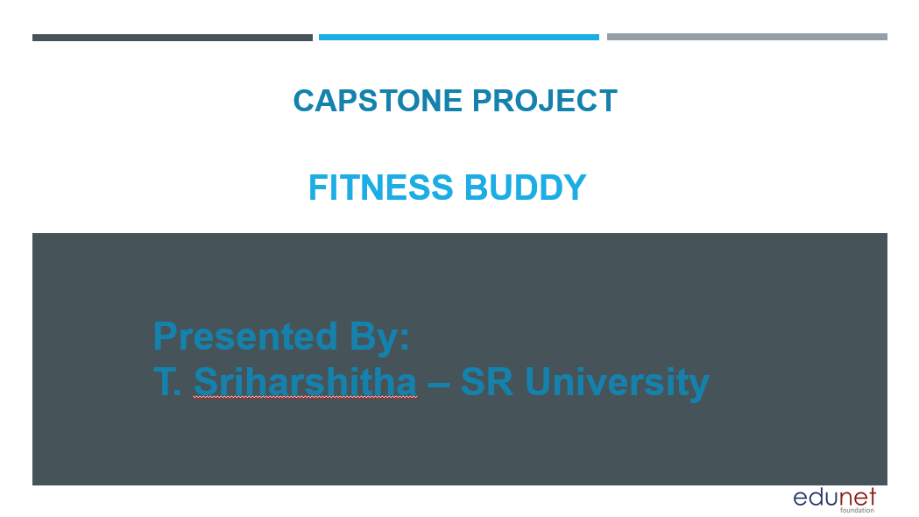

Slide 2
OUTLINE
1. Problem Statement
2. Proposed System/Solution
3. System Development Approach (Technology Used)
4. Algorithm & Deployment
5. Result (Output Image)
6. Conclusion
7. Future Scope
8. References

Slide 3
Problem Statement
In today’s fast-paced world, many individuals struggle to maintain a healthy lifestyle due to lack of personalized guidance, time constraints, and inconsistent motivation. Traditional fitness solutions often require expensive subscriptions, in-person consultations, or rigid schedules that don't adapt to personal routines.
There is a growing need for an accessible, friendly, and intelligent virtual assistant that can provide on-demand fitness advice, healthy lifestyle suggestions, and basic nutrition guidance—all tailored to individual needs and available at any time.

Slide 4
Proposed Solution
Fitness Buddy helps users stay healthy with the support of IBM Cloud services. Key features include:
Recommend home workouts and routines based on user input
Provide motivational tips and daily fitness inspiration
Suggest simple, nutritious meal ideas
Encourage habit-building and consistency

Slide 5
System Development Approach
System Requirements:
IBM Cloud Lite
Watsonx Assistant
IBM Granite Model
Libraries/Services:
Chat interface using Watsonx Assistant
Backend logic with Python/Node.js
Database for user profile and goals
Architecture: User Input → Analyze Preferences → Generate Recommendations → Display via Chatbot

Slide 6
Algorithm & Deployment
Input: User provides fitness level, goal (weight loss/gain), dietary preferences, available workout time.
Algorithm: Combination of rule-based filters and clustering-based personalization.
Meal Planning: Logic-driven daily suggestions based on user restrictions (e.g., vegetarian, high-protein).
Deployment: Hosted on IBM Cloud Lite with Watsonx Assistant front-end. Optional web/mobile interface.

Slide 7
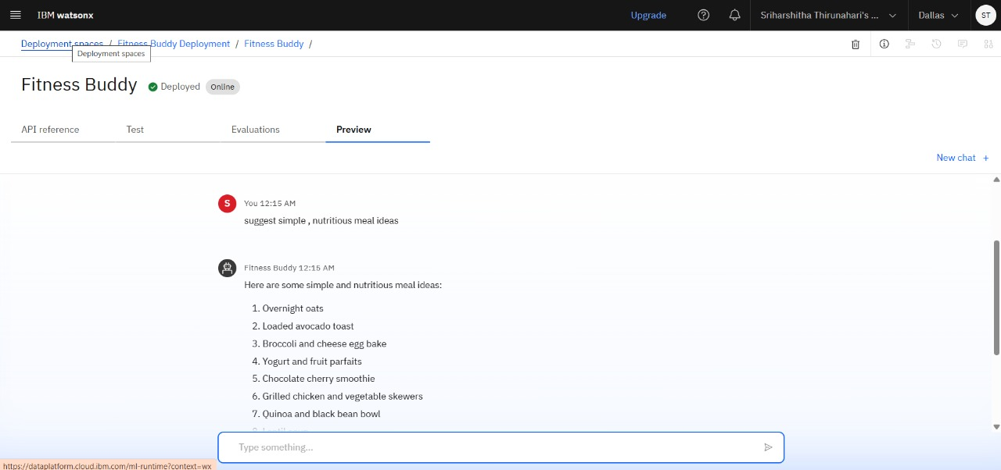
Result
Fitness Buddy successfully delivers personalized workout and nutrition guidance through an AI-powered chatbot,
making healthy living simpler, accessible, and more consistent for users.

Slide 8
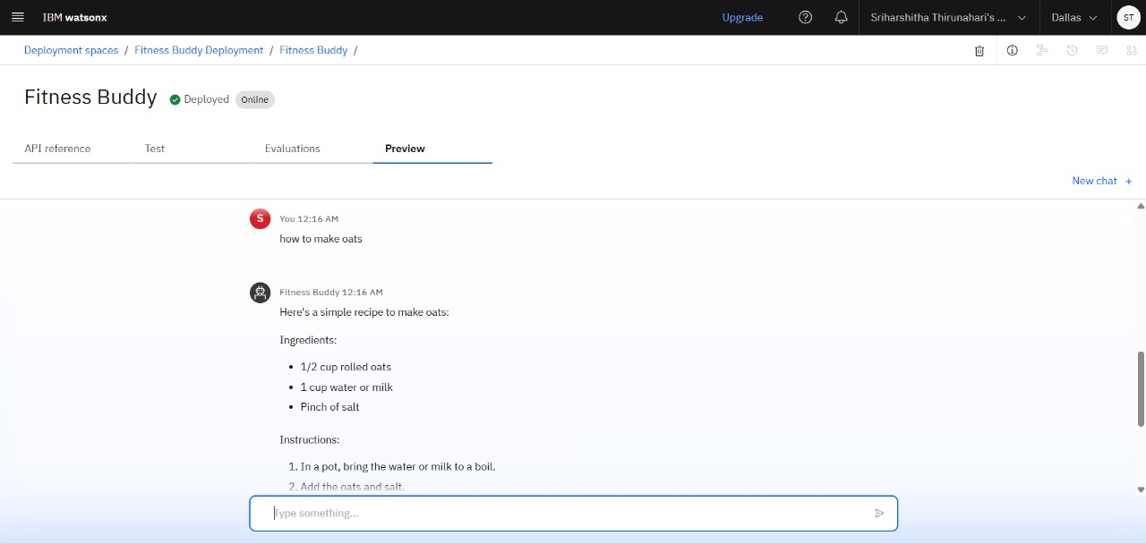
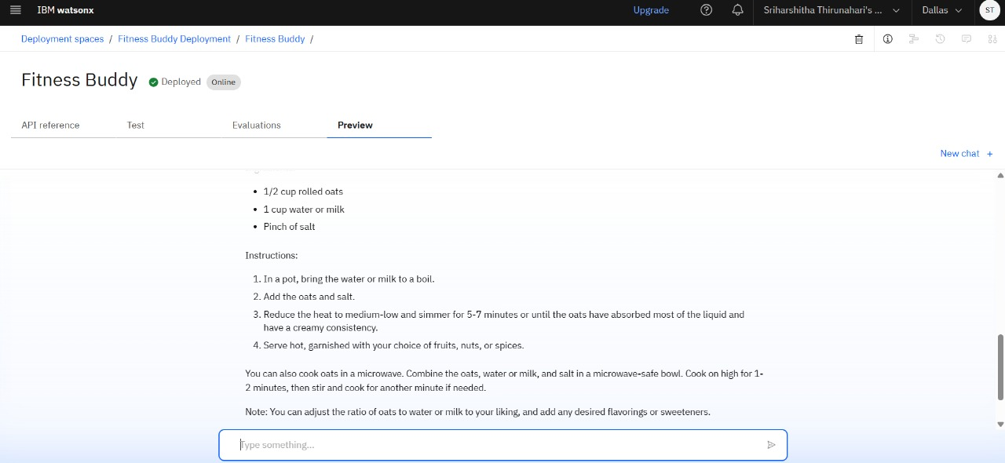

Slide 9
Conclusion
Fitness Buddy solves the problem of inconsistent motivation and rigid schedules in fitness routines.
It makes personalized health guidance accessible and adaptable through IBM’s AI tools.
The solution is simple, motivational, and effective in helping users maintain a healthy lifestyle.

Slide 10
Future Scope
Integration with fitness wearables (like Fitbit, Apple Watch)
Voice assistant features for hands-free interaction
Multilingual chatbot support
AI-based mental wellness guidance
Gamified features like daily challenges and progress tracking

Slide 11
References
1. IBM Cloud Documentation
Watson Assistant Developer Docs
WHO Guidelines on Physical Activity
Harvard Health – Fitness & Diet Research
IBM Granite AI Documentation

Slide 12
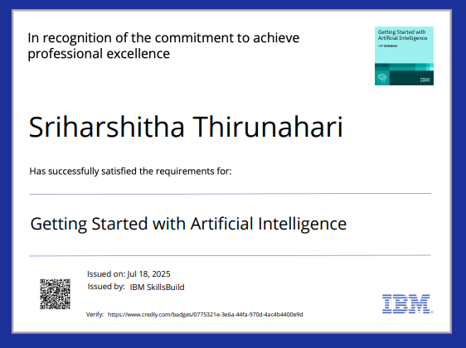
Ibm certifications

Slide 13

Ibm certifications

Slide 14
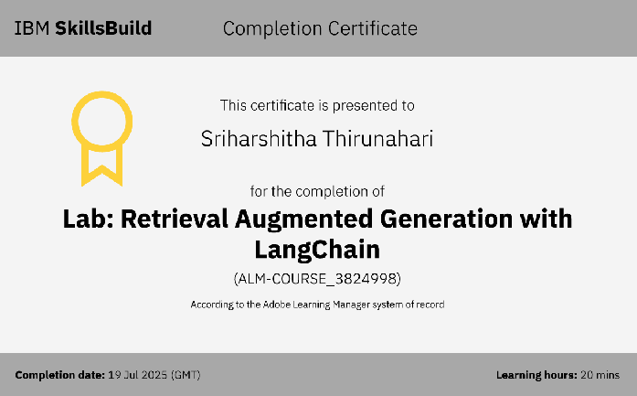
Ibm certifications

Slide 15
THANK YOU!

